Slide 1


DIGITAL FAIR SKILL 35.0
STAR TYPE CLASSIFICATION WITH
K-Nearest Neighbors
Created by: Naufal Fathi Rizqy Fadhilah

Slide 2
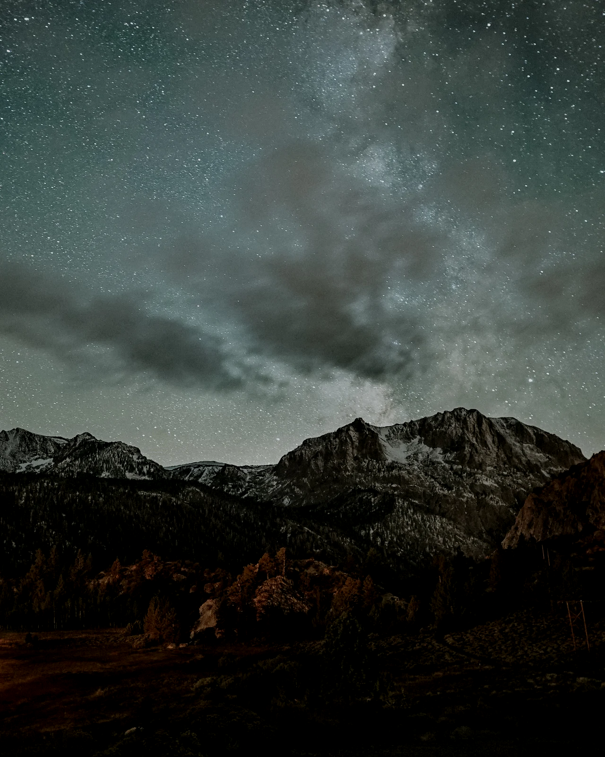
INTRODUCTION
The dataset contains information about various types of stars, including temperature, luminosity, radius, and absolute magnitude.
Research on stars and their classification is essential in astronomy. K-Nearest Neighbors is a machine learning algorithm well-suited for classification tasks.
Objective: To apply the K-Nearest Neighbors algorithm to classify star types based on their characteristics.
Digital Fair Skill 35.0

Slide 3
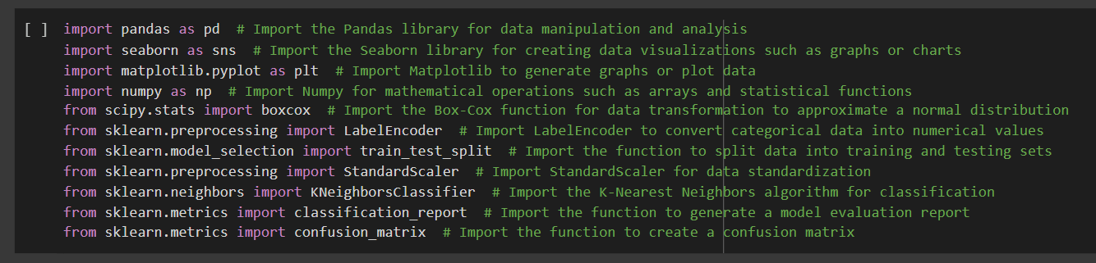
LIBRARY IMPORT
Digital Fair Skill 35.0

Slide 4
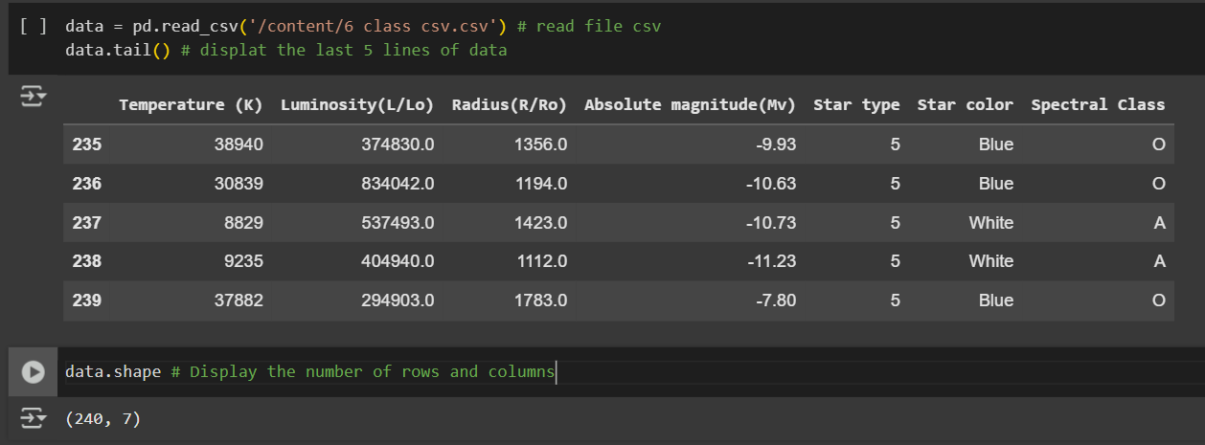
DATA DESCRIPTION
Displays the last 5 rows and dataset size (number of rows and columns) using data.tail() and data.shape.
DATA EXPLORATION
Digital Fair Skill 35.0

Slide 5
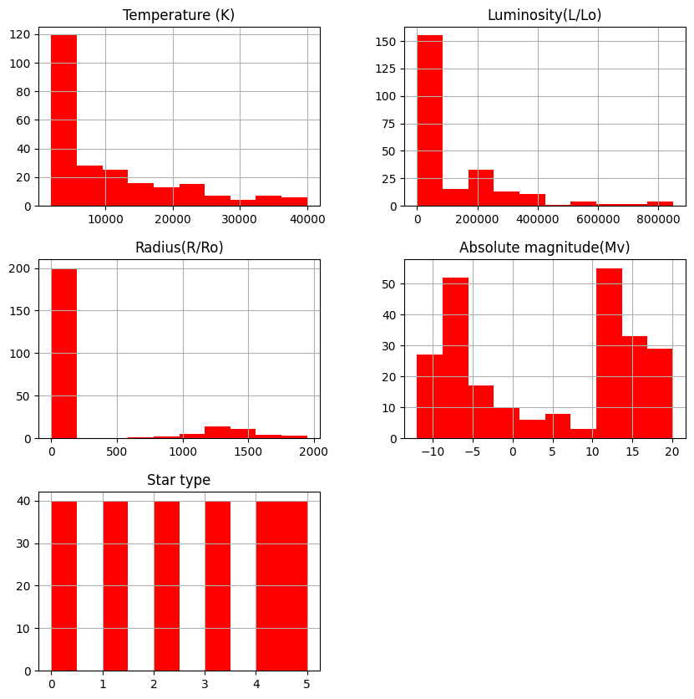
DATA VISUALIZATION
Histogram: Displays data distribution using data.hist().
Digital Fair Skill 35.0

Slide 6
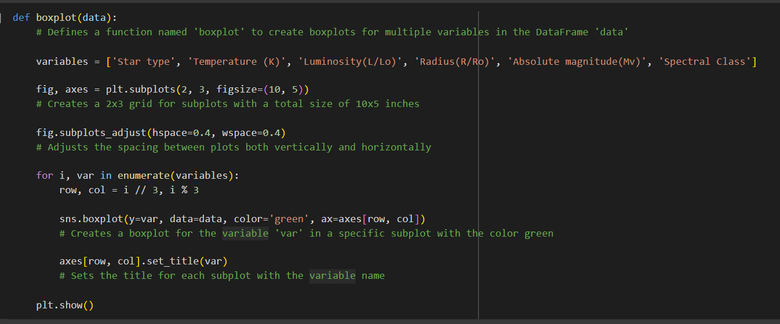
DATA VISUALIZATION
2. Boxplot: Detects outliers in each variable using the boxplot() function.

Slide 7
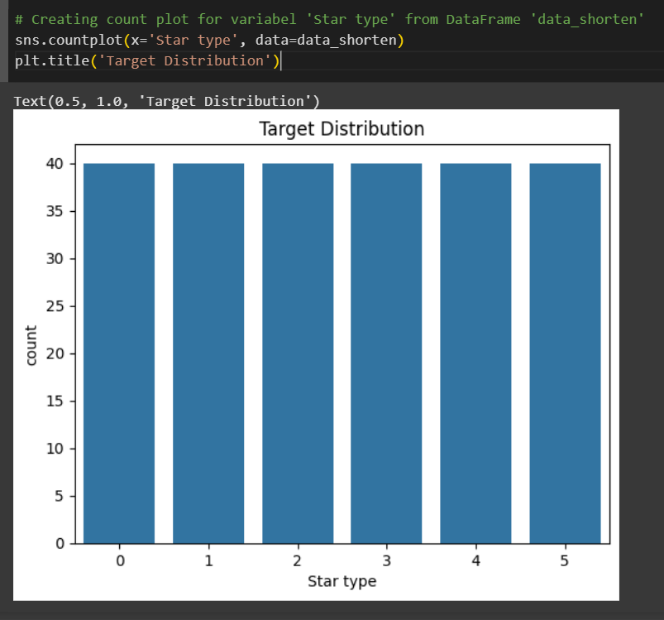
DATA VISUALIZATION
3 Countplot: Shows the distribution of the target class (star type) using sns.countplot().

Slide 8
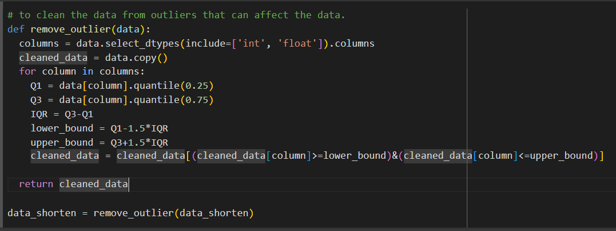
DATA CLEANING
Removing outliers using the remove_outlier() function.

Slide 9
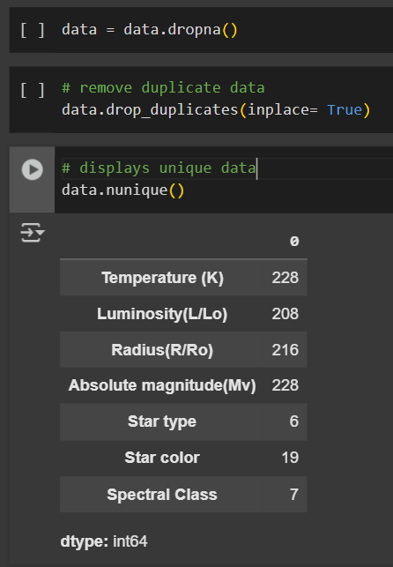
DATA CLEANING
2. Removing missing values and duplicate data using data.dropna() and data.drop_duplicates().

Slide 10

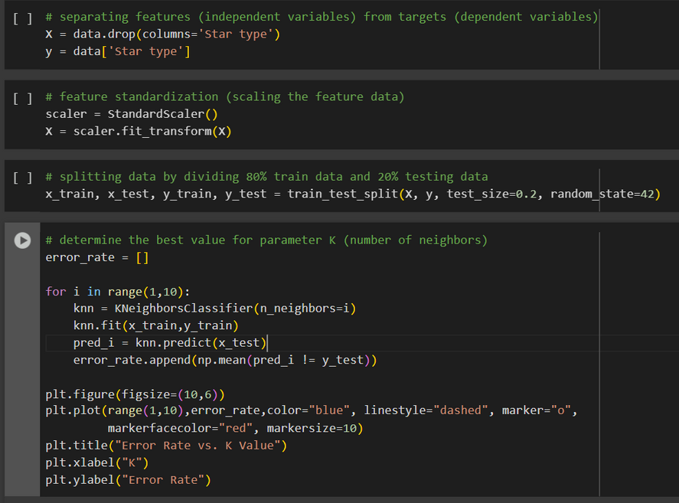
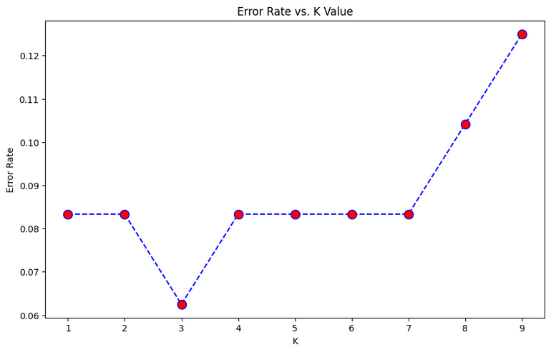
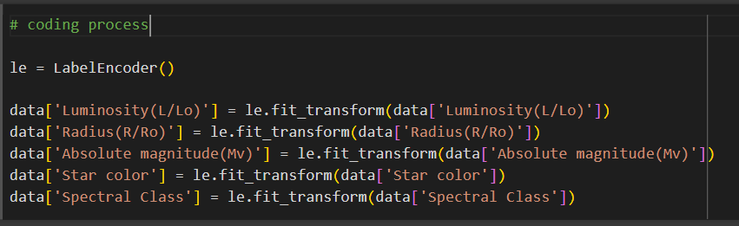
DATA PREPROCESSING
ENCODING
Converts categorical data into numerical values using LabelEncoder for columns such as 'Luminosity', 'Radius', 'Absolute Magnitude', 'Star Color', and 'Spectral Class'.
Standardization: Scales feature data using StandardScaler.
Data Splitting: Splits data into training (80%) and testing (20%) sets using train_test_split.

Slide 11
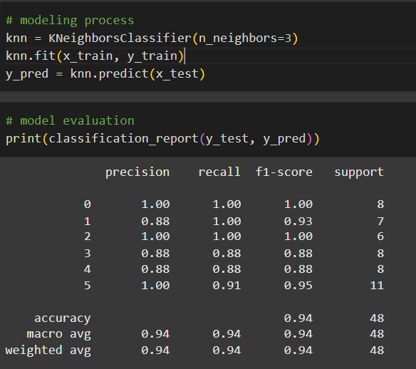
MODELING WITH K-NEAREST NEIGHBORS
CHOOSING K VALUE
Determines the optimal K value by analyzing error rates using loops and visualization.
2.MODEL TRAINING
Trains the KNN model with the optimal K value using knn.fit().
3.PREDICTION
Makes predictions on test data using knn.predict().
Digital Fair Skill 35.0

Slide 12
MODEL EVALUATION
CLASSIFICATION REPORT
Displays precision, recall, f1-score, and accuracy using classification_report().
2.CONFUSION MATRIX
Visualizes model performance using confusion_matrix() and sns.heatmap().
3.PREDICTION
Makes predictions on test data using knn.predict().
Digital Fair Skill 35.0

Slide 13
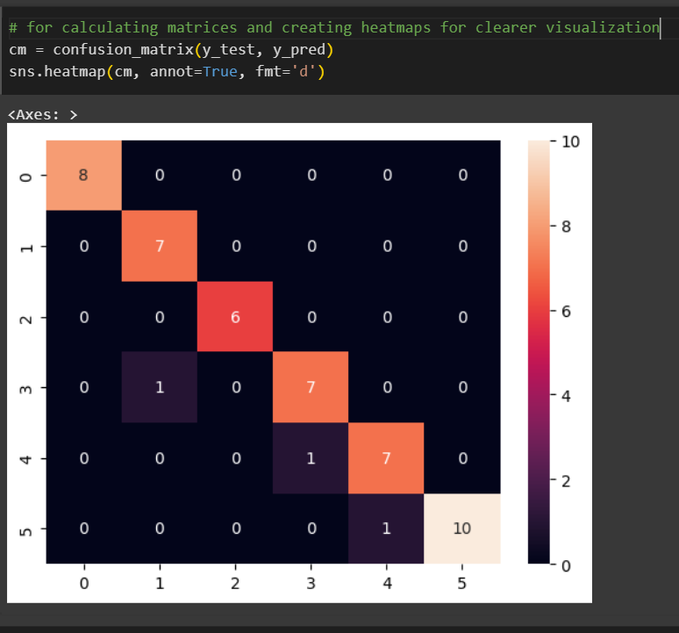
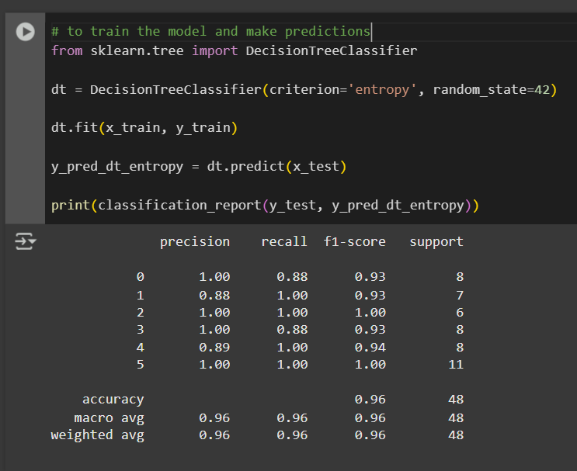
MODEL EVALUATION
Digital Fair Skill 35.0

Slide 14
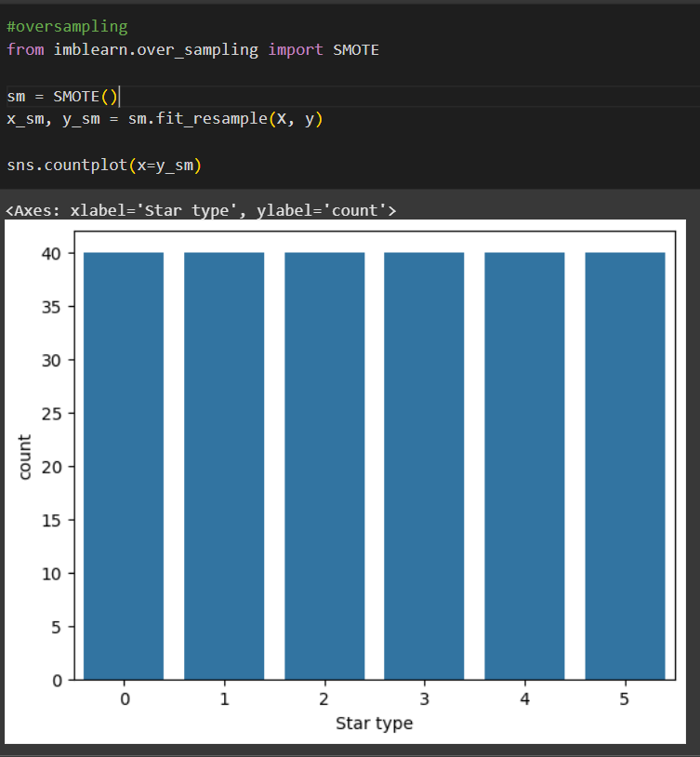
HANDLING DATA IMBALANCE (OVERSAMPLING)
SMOTE
Applies the SMOTE technique to handle class imbalance using SMOTE().
2.MODEL EVALUATION
Retrains and reevaluates the KNN model using the oversampled dataset.
Digital Fair Skill 35.0

Slide 15
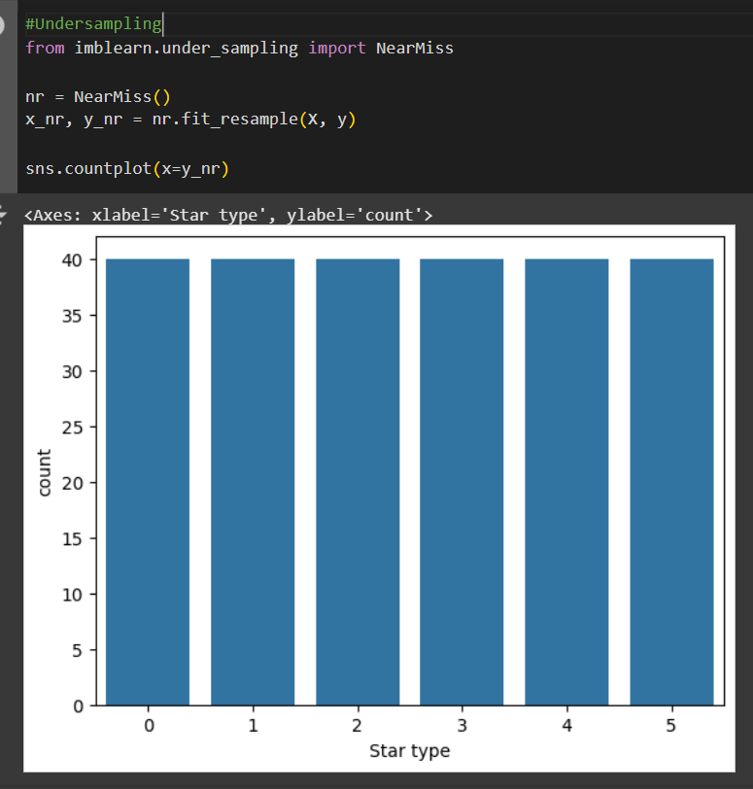
HANDLING DATA IMBALANCE (UNDERSAMPLING)
NEARMISS
Applies the NearMiss undersampling technique using NearMiss().
2.MODEL EVALUATION
Retrains and reevaluates the KNN model using the undersampled dataset.
Digital Fair Skill 35.0

Slide 16
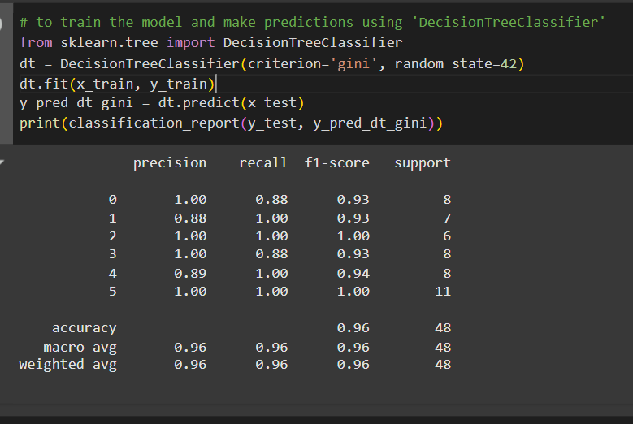
DECISION TREE
MODELING WITH DECISION TREE
Trains a Decision Tree model using Gini and Entropy criteria.
2.MODEL EVALUATION
Evaluates the Decision Tree model using a classification report.
Digital Fair Skill 35.0

Slide 17
CONCLUSION
Summarizes the outcomes of KNN modeling, including model performance and the best technique for handling data imbalance.
Provides recommendations for model improvement or future research directions.
BIJOU TRAVEL & TOURS | 2020

Slide 18
THANK YOU

